Slide 1
Providing trending Venues

Slide 2
Introduction
-Traveling a new location is time consuming and stressful
-Recommend trending and venues based on interest where to stay
-Partnership with trendy venues to provide better service
-Make our own mobile application for the recommendation

Slide 3
Data
latitude, longitude, restaurants, and restaurant ratings, trendy locations, and tips are required. All data related to locations will be obtained via the Foursquare API utilized via the Request library in Python.
.

Slide 4
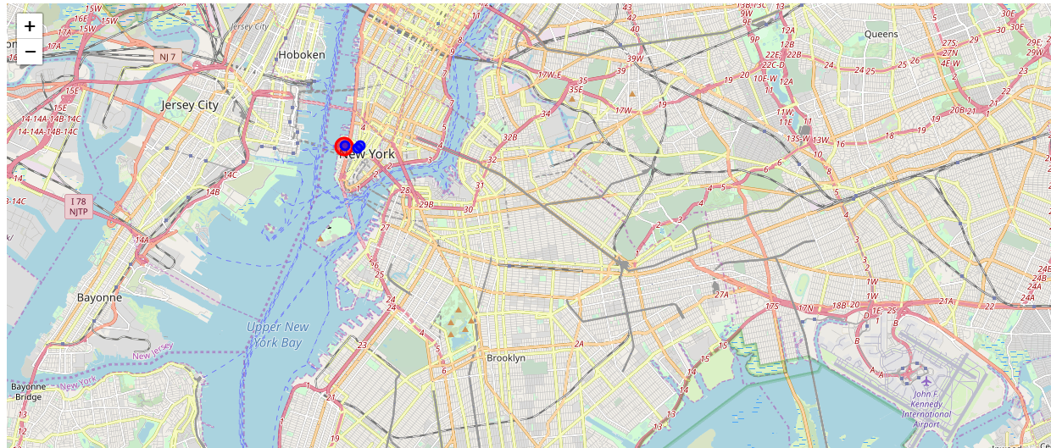
Methodology
Foursquare API Search Function

Slide 5
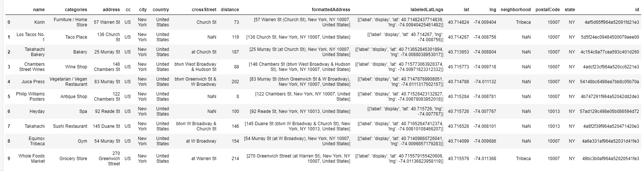
Methodology
Explore a Given Venue
Foursquare API Explore Function
Get Trending Venues

Slide 6
Results and Discussion
Based on my customer's hotel location and food preference: Italian, we found an Italian restaurant Ecco that best fit to my customer's interest. However, Foursquare cannot recommend hot places to explore around after meal. To resolve it, I would go with other data source or upgrade the membership of Foursqure to have bigger data sets. In addition, I would consider building our own travel app for recommendations so that they can use it anywhere anytime.

Slide 7
Conclusion
Providing recommendations for trending venues via our own app development will help us differentiate from our competitors.

